Slide 1
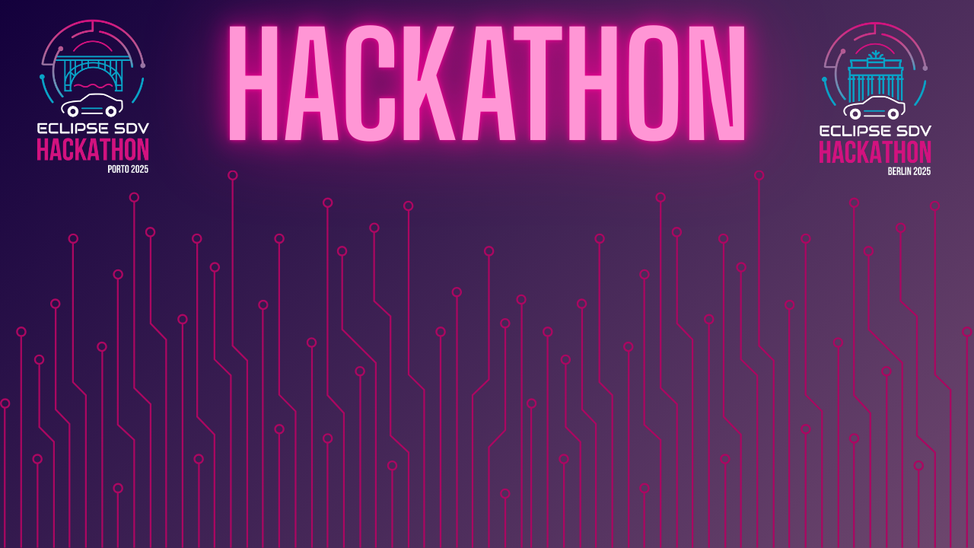

Chapter III - 2025
COPYRIGHT (C) 2025, ECLIPSE FOUNDATION

Slide 2
PITCHING SESSION DEN-Team
COPYRIGHT (C) 2025, ECLIPSE FOUNDATION

Slide 3








Safeguard – Safety & Compliance Layer for Eclipse SDV OTA
Challenge: Eclipse SDV (Symphony + Ankaios) updates efficiently, but lacks safety, compliance, and intelligence:
Safe update
Standard compliance
Intelligence
Solution: Enhances OTA safety, reliability by introducing new features:
Decrease trustiness and success update
Increase downtime and restoring cost
Driver consent
Monitor vehicle state
Update starts only with driver consent
Update starts only when cars meet expected condition
OTA history
AI-driven failure analysis
Update and vehicle state history help achieve compliance with the UN R155 standard
Diagnose update failures by analyzing vehicle state history

Slide 4
Team and Structure
Our team members were primarily divided by components:
Satoshi : Symphony-Ankaios system communication
Mandar : ECU level architecture
Rihab, Ayane : Update functionality
Priyanka : System integration
In the end, we collaborated to integrate the system piece by piece.

Slide 5
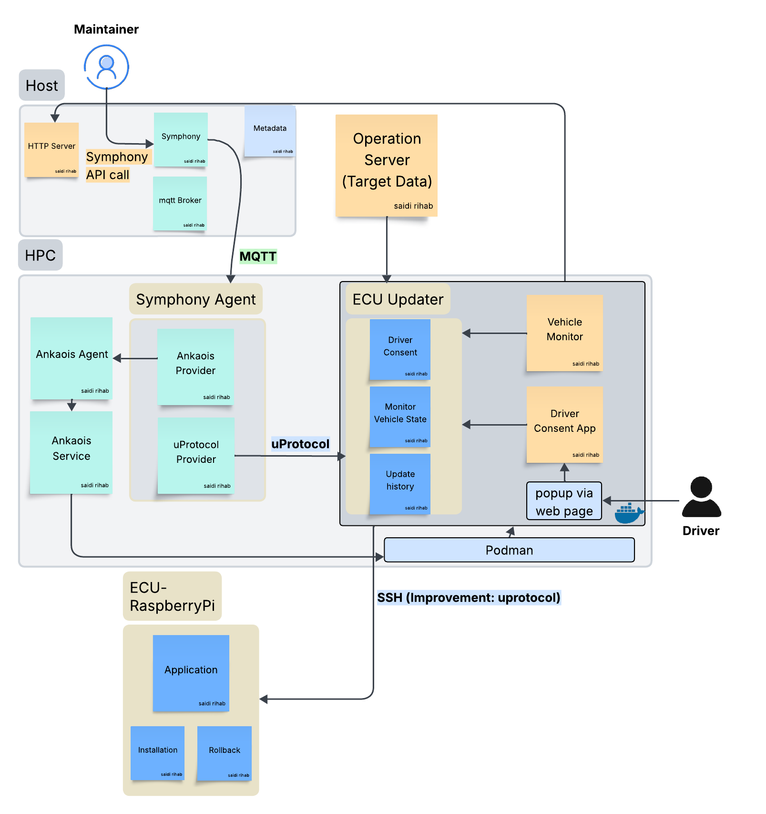
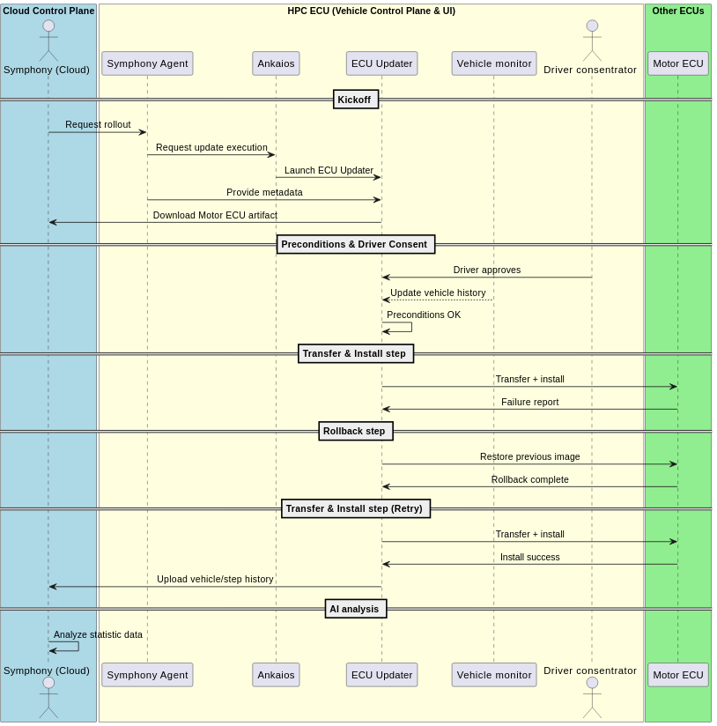
The Product / Service

Slide 6


Value of the proposed solution
Added value
Real-World Safety: Update only when vehicle is safe enough → reduced risk & downtime.
Driver-Centric: User approval improve transparency and avoid unexpected behaviour.
Compliance & Trust: for UN R155/R156 regulations (Compatibility for AUDIT)
Future-Proof: Tracker data enables AI/analytics to decrease failure rate
Why Better Than Other Solutions
Save driver’s life
Safety is one the most critical topics in the automotive.
User consent and vehicle monitoring avoid unexpected accident while updating.
Enable continuous optimization for reliable OTA
Continuous feedback enables OEMs to refine their update strategies over time, leading to safer, more reliable, and cost-effective fleet management.

Slide 7
The Market & The Competition
- Can be licensed or offered as middleware for OEMs using OSS SDV.
- Supports fleet management analytics via tracker data.
- Scalable: Works for single vehicle deployments to entire fleets.
Future AI capabilities unlock predictive maintenance, anomaly detection, and optimized update scheduling.
Regulation-ready: Traceability ensures easier compliance with UN R155 (cybersecurity) and R156 (software updates).
Competitive with OEM solutions: Safeguard brings compliance + trust to Eclipse SDV OTA, making OSS viable for real-world fleets.
OEM Differentiation: Driver approval & state-awareness = marketable as a “safe update” feature.
Future AI: Tracker data becomes the foundation for predictive insights → fleet maintenance optimization, energy-aware updates.

Slide 8
Business Model * Plan & Funds
1. Generating Sales
Fleet Operator Subscriptions: Charge fleets (delivery, rental, logistics) for enhanced OTA safety, driver approval, and compliance logging.
OEM Licensing: Offer Safeguard as a licensed middleware layer to OEMs using Eclipse SDV OSS stack for compliance-ready OTA.
2. Business Model Implementation
Integration Packages: One-time fee for Safeguard integration with existing SDV stack and OEM dashboards.
Data Insights Upsell: Optional tier for AI-ready data analysis, predictive scheduling, and fleet optimization.

Slide 9
Contact
List the contact details of the people in charge of the different aspects of the “business”.

Slide 10
Thank You slide
Thank your audience and encourage them to get in touch afterwards.
COPYRIGHT (C) 2025, ECLIPSE FOUNDATION

